Slide 1

CS 533 INTRO TO DATA SCIENCE
Michael Ekstrand

Slide 2
SAMPLING AND THE DATA GENERATION PROCESS

Slide 3

Learning Outcomes
Understand the relationship between a sample and a population
Identify when we can make an inference about the population and when it’s just a statistic of the data
Determine whether data is likely to be independent and identically distributed
Photo by Dan Meyers on Unsplash

Slide 4
Sampling
The inferential logic of statistics is based on samples
From a distribution
Generate random numbers!
From a population
Select them with a representative sampling strategy

Slide 5


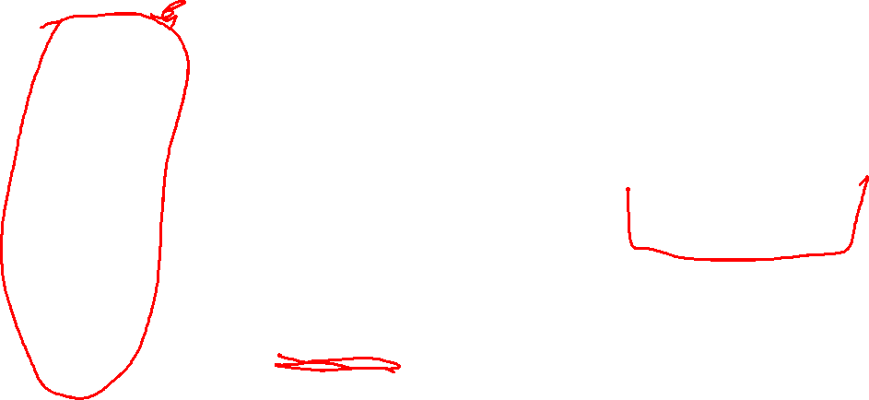
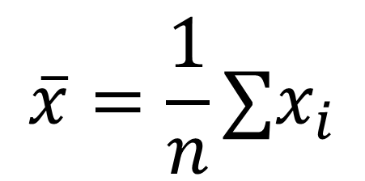
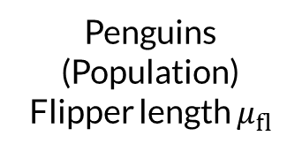
Sampling the Population
Ideal Penguin
Penguins
(Population)
Flipper length $μ_{fl}$
Sample of Penguins
Statistic
$$\overline{x}=\frac{1}{n}∑x_{i}$$
Is the sample representative?
Does it teach us about population?

Slide 6
Representative Samples
We need a couple of things for a sample:
Representative of the population (w.r.t. parameter of interest)
Biases affect this (sampling, selection, response, etc.)
Large enough to allow inference of parameter of interest
This size does not depend on population size!
Better data often better than more data!
Historically, much statistics concerned w/ efficiently using samples

Slide 7
Uniform Sampling
All population members equally likely to be sampled
Harder than it sounds in practice
Resulting statistical analysis relatively straightforward
Small subgroups easy to omit!

Slide 8
More Strategies
Stratified Sampling
Make sure different groups are represented, possibly equally
Oversampling
Sample more from a minority group for in-group data
Correct (resample or reweight) for whole-sample inference

Slide 9
Penguins
We have:
3 species of penguin
Measurements for a sample within each
What is the population?
Can we answer:
Distribution of penguin species?
Typical measurements within a species?

Slide 10

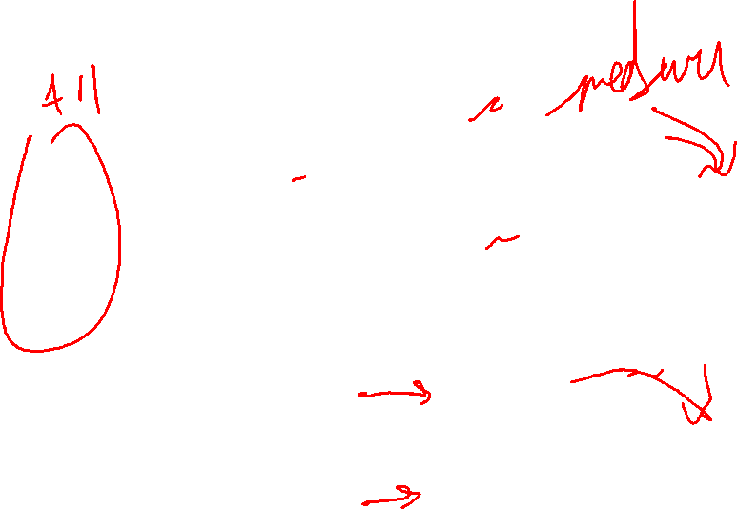
Two Sampling Strategies
Spec. 1
sample
Analysis
Spec. 2
Spec. 1
Sample 1
Analysis
Spec. 2
Sample 2

Slide 11
The Data Generating Process
How did we get our data?
People and movies exist
People find movies and watch them
Netflix recommends more movies
People maybe watch them (feed back into 2)
Reasoning about DGP helps identify sample status,

Slide 12
I.I.D.
Common desiderata for values, and samples:
independent and identically distributed
Independent: one value does not affect another
Identically distributed: all drawn from the same distribution
Equal mean, variance, distribution family
Uniform at random from large pop is i.i.d.
Small pop: sampling removes items! (unless with replacement)

Slide 13
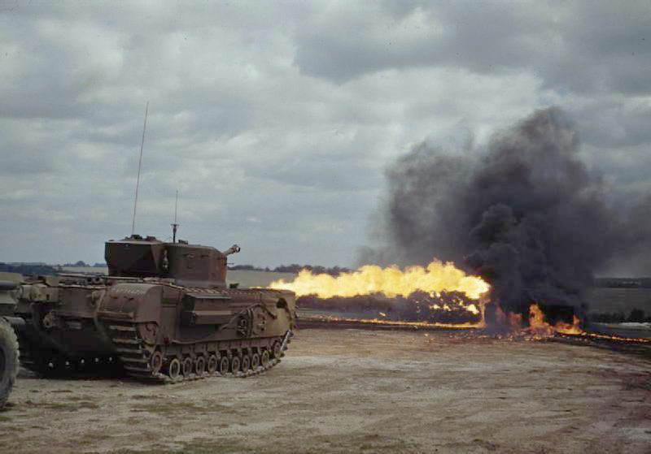
German Tank Problem
You capture a tank.
It has serial number 2089.
How many tanks does the enemy have?
This is inference for the max.

Slide 14
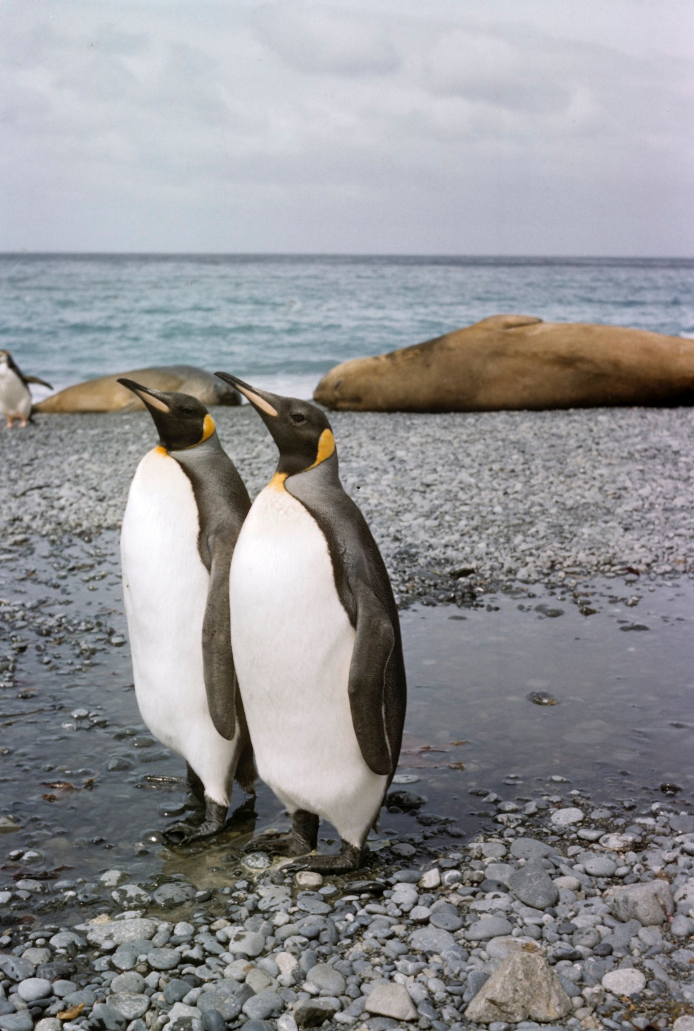
Wrapping Up
Our data comes by some process.
Classically, we think about this in terms of sampling – how did we pick these items to analyze?
The data generation process is how our data comes into existence.
Photo by Museums Victoria on Unsplash

